Slide 1
Preliminary Damage Assessment

Slide 2
Purpose of Preliminary Damage Assessment (PDA)
Is used to document the impact and magnitude of the disaster to public property. Information gathered is also used for disaster management.
This information will help the Governor decide if Federal assistance is needed.
Allows the state to show the Federal Government that we have met required thresholds mandated in CFR to be awarded assistance.

Slide 3
Preliminary Damage Assessment Process
South Dakota OEM doesn’t mandate how damage must be captured and recorded. Whatever works best for you and your jurisdiction.
Information should be as detailed as possible with complete and accurate information.
Photos have become the most important item during a PDA, as without them FEMA may not include damage numbers.
All information must be sent through your County Emergency Manager before making it to SDOEM.

Slide 4
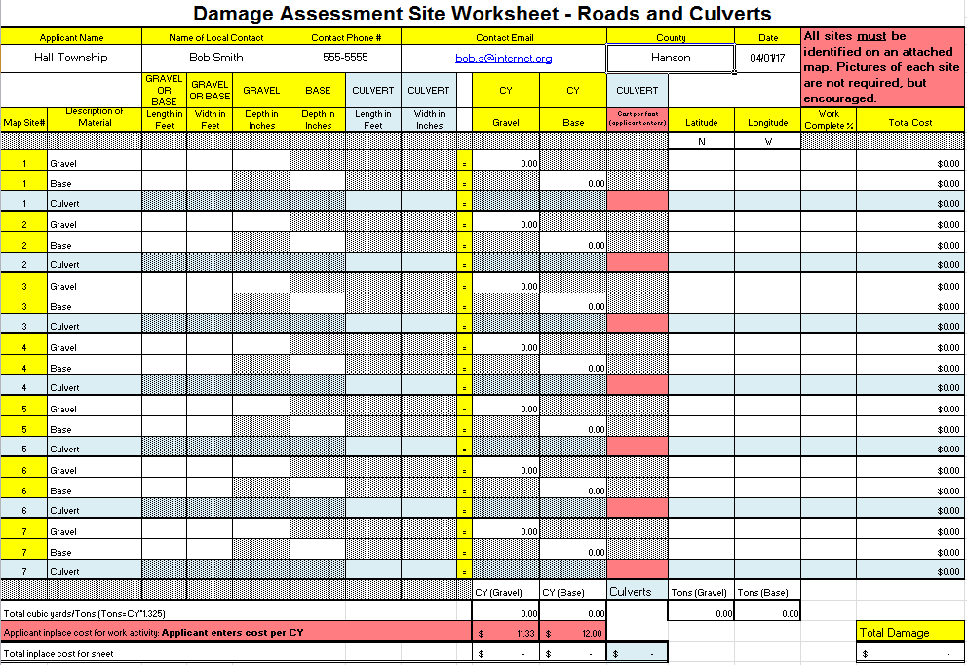
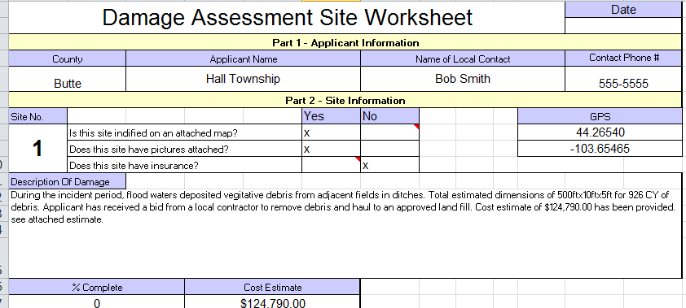
Submittal Options
Examples of forms that were used in past events to submit damage information for PDA.

Slide 5
Damage Assessment Software
SDOEM in 2021 started searching for a Preliminary Damage Assessment data collection software to provide another tool to jurisdictions in South Dakota.
Late 2021 a software solution was chosen by the name of Crisis Track. Software requirements and implementation has been on going to meet BIT technical requirements.
SDOEM just conducted training in October with 28 counties attending with around 75 attendees. These attendees with County Emergency Managers and Highway Staff.

Slide 6
Damage Assessment Software
Crisis track allows damage information entry by web-based program, mobile application, and web-based form.
Damage captured can be viewed by your County Emergency Manager and the State of South Dakota staff in real time.
Small structure inventory uploaded into Crisis Track allowing reference data during PDA.
Information captured in Crisis Track will provide historical tracking of damage as information is not deleted.

Slide 7
Damage Assessment Software
Which method you use for entry will need to be discussed with your County Emergency Manager.
Additional in person training will be coming in late Winter/early Spring of 2023. Those training dates will be announced soon.
Instructional presentations, videos, condensed trainings, and guides will be created and shared.

Slide 8
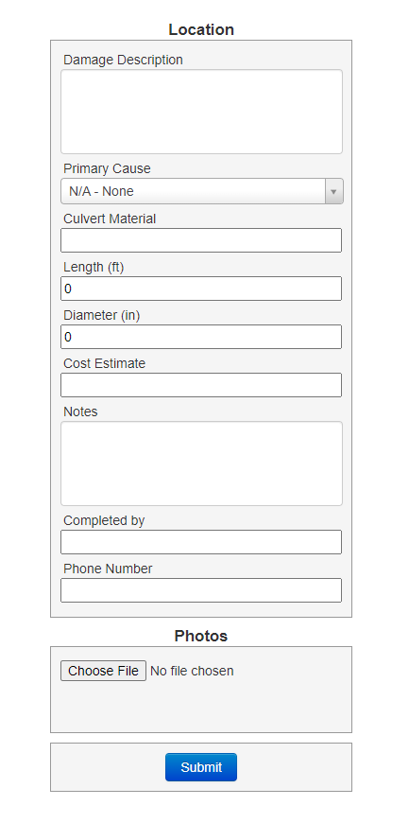
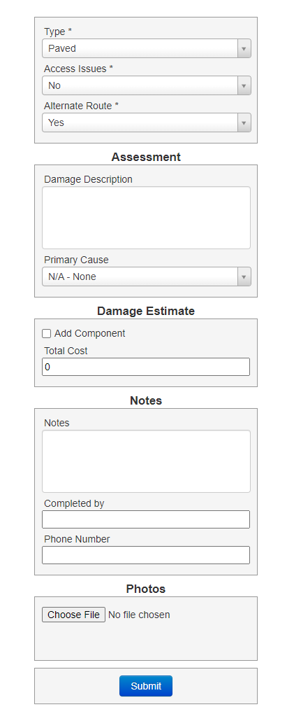
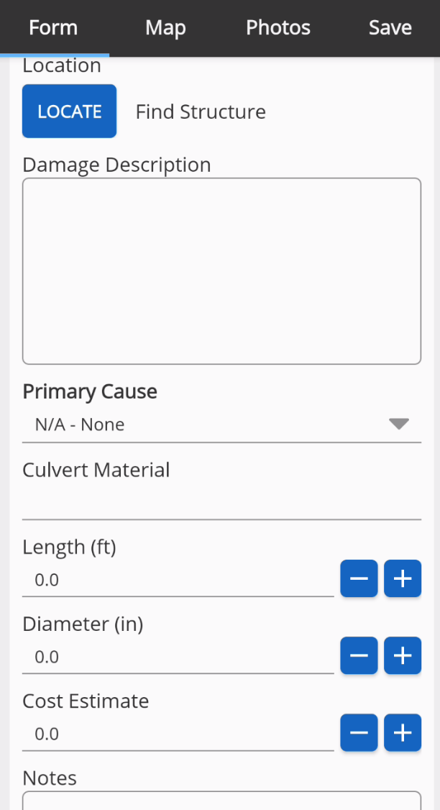
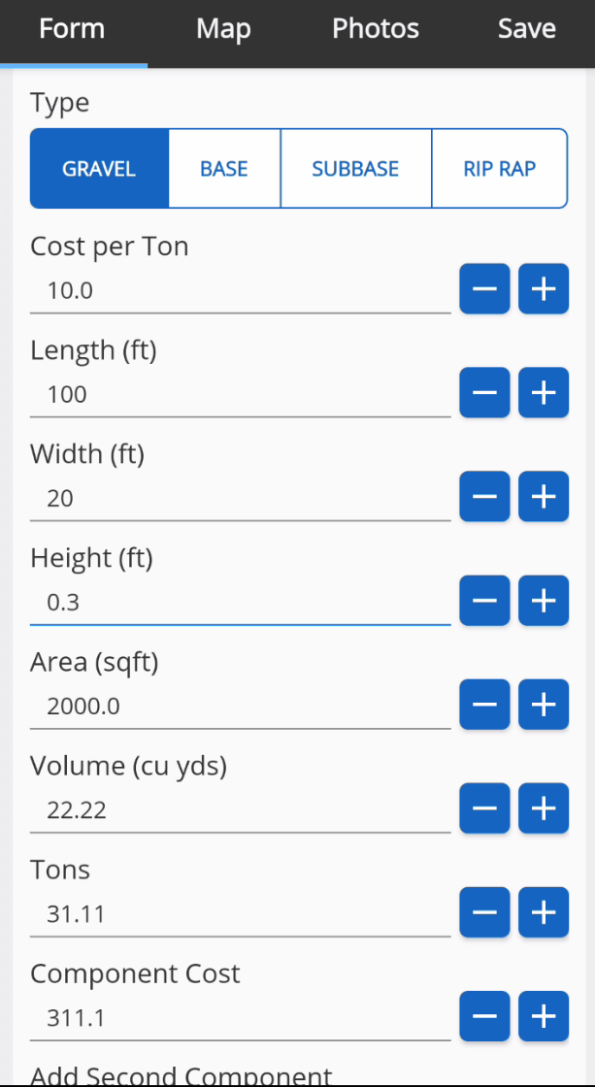
Screen Shots

Slide 9
Large Project Threshold Change
August 3rd, 2022, FEMA implemented a regulatory change to increase the small project maximum to $1 million dollars.
Of the 2019 disasters, SD had 137 large projects with the old threshold. Would only have been 12 with the new threshold.
This means less administrative work and payments made upon obligation regardless if work is completed. Any excess funds are kept and used for eligible PA expenses.
Still must follow all application laws, regulations, and policies. This new regulation is not retroactive to disasters before March 13, 2020.

Slide 10
Have Questions?
If you have any questions or need assistance, contact the South Dakota Office of Emergency Management.
Jim Poppen – Recovery and Mitigation Manager
Amanda VanderPlaats – PA Coordinator
Dustin Hight – PA Coordinator
Dale Farmen – PA Coordinator
Phone: (605) 773-3231

