Slide 1
2021 SDATAT ANNUAL CONVENTION ACCOUNTING & COMPLIANCE
Rod Fortin
Director of Local Gov’t Assistance
Department of Legislative Audit
300 S. Sycamore Avenue, Suite 102
Sioux Falls, SD 57110-1323
ph. (605) 367-5810
rod.fortin@state.sd.us
Notes:
2010 ASBSD and SASD Conference
1

Slide 2
Annual Report
The township treasurer shall prepare an annual report…. in the form prescribed by the auditor general….within 5 days of the annual meeting (1st Tues in March)….and file it with:
Clerk SDCL 8-10-30
County auditor SDCL 6-9-1
by the last day of March.

Slide 3
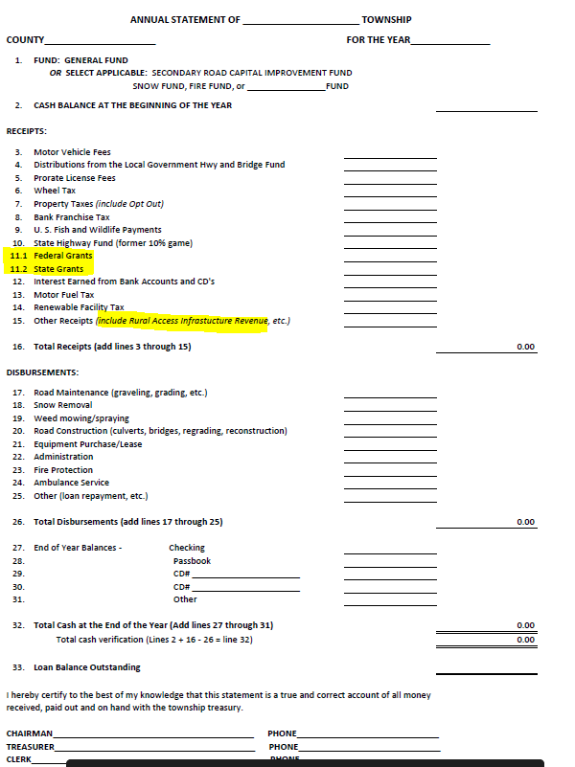

Slide 4
Annual Report
Please use most current version available on DLA’s website.
http://legislativeaudit.sd.gov/resources/resources.aspx
Or DLA’s website http://legislativeaudit.sd.gov/
Resources
Townships
Please use account numbers provided.
Please file separate annual report(s) for each Fund maintained (General Fund, Secondary Road Capital Improvement Fund, Snow Fund, etc.).

Slide 5
Annual Report
In accordance with SDCL 31-34-6, one of the requirements for Townships to be eligible for rural access infrastructure funds is that the requesting township shall timely file an annual report pursuant to SDCL 8-10-30.

Slide 6
NOW AVAILABLE
Excel Records for Townships
Narrative on Excel Records for Townships
Example 1 – Receipt Journal
Example 2 – Disbursement Journal
Example 3 – Fund Cash Balance Record
Example 4 – Revenue and Expenditure Budget Record
Example 5 – Cash Reconciliation Worksheet
Example 6 – Accounts Receivable Record
Example 7 – Individual Payroll and Leave Record
Example 8 – Township Voucher

Slide 7
Excel Records of Townships
Available on DLA’s website.
http://legislativeaudit.sd.gov/resources/resources.aspx
Or DLA’s website http://legislativeaudit.sd.gov/
Resources
Townships

Slide 9
Example 1 – Receipt Journal

Slide 10
Example 2 – Disbursement Journal

Slide 11
Example 3 – Fund Cash Balance Record

Slide 12
Example 4 – Revenue and Expenditure Budget Record

Slide 13
Example 5 – Cash Reconciliation Worksheet

Slide 14
Example 6 – Accounts Receivable Record

Slide 15
Example 7 – Individual Payroll and Leave Record

Slide 16
Example 8 – Township Voucher

Slide 17
Conflict of Interest
“No township officer shall become a party to or interested directly or indirectly in any contract made by the township of which he is an officer” SDCL 8-9-2
However, AGR 70-47 implies that the exceptions of SDCL 6-1-2 will apply

Slide 18
Large Equipment Purchase
No township may lease or purchase any road grader or other machine or tool the cost of which exceeds $15,000 without the approval of the voters of such township in the manner provided by law. SDCL 8-9-3

Slide 19
Lease Purchase
A township may enter into a lease purchase agreement for up to 10 years for the purchase or lease of real or personal property. Any lease-purchase agreement for a term exceeding one year requires the approval of more than sixty percent of the members-elect of the board of supervisors. (SDCL 8-10-32)

Slide 20
Contracts
“Contracts unlawful unless made at board meeting” SDCL 8-9-1

Slide 21
Expenditures
Township voters or upon their refusal, the township board, should select the depository to be used for township funds.
Must be located in SD
SDCL 8-10-5

Slide 22
Expenditures
SDCL 8-10-17 Warrant for accounts allowed
The amount of any account audited and allowed by the board of supervisors, and the amount of any account voted to be allowed at any township meeting shall be paid by the treasurer on the warrant of such board signed by the chairman and countersigned by the clerk; and all warrants issued to any person by the board for any sum due from the township shall be receivable in payment of township taxes

Slide 23
Expenditures
Unless it is cost prohibitive, it is strongly encouraged that each township should arrange with its depository to not only have the monthly bank statement/cancelled checks sent to the treasurer but also have a duplicate copy sent to another officer of the township to provide checks and balances.
8-6-1. Bond required of clerk
8-7-1. Bond required of treasurer

Slide 24
2021 Session
HB1259 – An Act to make an appropriation for rural access infrastructure improvements and to declare an emergency.
Section 1. That a NEW SECTION be added:
31-34-1. Definition. For the purposes of this Act, the term, small structure, means any small bridge or culvert with an opening of sixteen square feet or more located on a township road or county secondary road, excluding bridges as defined in § 31-14-1.

Slide 25
Section 2. That a NEW SECTION be added:
31-34-2. Fund distribution by state--Inventory--Grants.
Before August 1, 2021, the Department of Revenue shall distribute the sum of three million dollars on a pro rata basis to each county for the purpose of planning and completing an inventory of small structures as prescribed by the Department of Transportation. Before August 1, 2022, the Department of Revenue shall distribute a portion of the sum of three million dollars to each county based on the allocation calculated in accordance with this section for the purposes described in § 31-34-3. Each county's allocated percentage is calculated by using the total number of small structures on township roads and county secondary roads located in a county divided by the sum of all small structures on township roads and county secondary roads in the state as reported to the Department of Transportation, multiplied by one hundred. Each county that receives funds from this rural access infrastructure program shall use the funds in accordance with the provisions of this Act.

Slide 26
Section 3. That a NEW SECTION be added:
31-34-3. Distribution of funds by county--Permissible uses.
Each county shall establish a rural access infrastructure fund for the deposit of funds received pursuant to this Act. The funds shall be distributed by the board of county commissioners for only the following expenses:
(1) Engineering, hydrological studies, planning, materials, and other costs as necessary to plan for and complete the projects;
(2) Construction, rehabilitation, or replacement of small structures located in townships complying with the requirements of this Act;
(3) Construction, rehabilitation, or replacement of small structures described in a county highway and bridge improvement plan that are located on county secondary highways.
The fund may not be used on no maintenance roads or minimum maintenance roads.

Slide 27
Section 4. That a NEW SECTION be added:
31-34-4. Application process.
Applications for use of funds allocated pursuant to this Act shall be submitted to the board of county commissioners on or before January fifteenth on forms prescribed by the association of county commissioners. The board of county commissioners shall award the funds no later than March fifteenth. Applications from townships shall be accompanied by a resolution approved by the township board of supervisors authorizing the application and any funding commitments made by the township. The township or county share shall be a minimum of twenty percent of the funds necessary to complete the project. Applications for county secondary highways shall be submitted by the county highway superintendent.

Slide 28
Section 5. That a NEW SECTION be added:
31-34-5. Criteria for award.
The board of county commissioners shall, at a minimum, consider the following
criteria in awarding rural access infrastructure grants:
(1) Traffic use of the highway;
(2) Public safety;
(3) Residential, commercial, recreational, and other uses of the highway;
(4) Cost of the project;
(5) Length of detour if the project is not completed;
(6) Number of residences, farms, and ranches served by the project;
(7) Contribution from township or others to the project and ability of township to fund
the project without utilizing the rural access infrastructure fund;
(8) Confirmation the project is not located on a no maintenance or minimum
maintenance road;
(9) Hydrological impact;
(10) If the highway does not terminate into a field entrance, driveway, single residence, farm, or ranch;
(11) The application, or group of applications, that best serves the citizens of this state; and
(12) Any other matters deemed applicable by the board of county commissioners.
The decisions of the county commissioner shall be final and nonappealable.
However, a denied application may be submitted in a subsequent year.

Slide 29
Section 6. That a NEW SECTION be added:
31-34-6. Township eligibility--Plan and annual report--Tax requirement.
A requesting township shall timely file the township small structure improvement plan pursuant to § 31-34-7 with the county highway superintendent and an annual report pursuant to § 8-10-30 in order to be eligible for the funds. Any township requesting use of rural access infrastructure funds pursuant to this Act shall meet at least one of the following requirements:
(1) Impose an annual property tax levy of fifty cents per thousand pursuant to § 10- 12-28.2; or
(2) Impose a tax levy opt out pursuant to § 10-13-36.

Slide 30
Section 7. That a NEW SECTION be added:
31-34-7. Township eligibility--Contents of plan--Updates.
To be eligible to receive funding from the rural access infrastructure fund
established under this Act, a township shall, each year by November fifteenth, submit to
the county that township is located in, a township small structure improvement plan and
any updates shall be made in accordance with this section. The township small structure
improvement plan shall include:
(1) One or more maps showing the location of all small structures within the township;
(2) The location, width, and length of each small structure;
(3) A report on the condition of each small structure;
(4) Whether the small structure is posted for load capacity, and if so, what the posted limit is;
(5) A list of all projects proposed to be undertaken by the township over the next five years including the location of the project, type of project, source of funding for the project, estimated cost of the project, and the year the project is proposed to
be completed; and
(6) Such additional items as may be prescribed by the Department of Transportation.

Slide 31
Section 8. That a NEW SECTION be added:
31-34-8. County use of funds conditioned.
The county commission may use rural access infrastructure funds for the
construction, rehabilitation, or replacement of small structures on county secondary highways so long as such projects are considered in a similar manner as the small structures that are located within an organized township.
Section 9. There is hereby appropriated from the general fund the sum of $6,000,000 to the Department of Revenue for the purpose of distribution to county rural access infrastructure funds.
Section 10. The secretary of the Department of Revenue shall approve vouchers and the state auditor shall draw warrants to pay expenditures authorized by this Act.
Section 11. Any amounts appropriated in this Act not lawfully expended or obligated shall revert in accordance with the procedures prescribed in chapter 4-8.
Section 12. Whereas, this Act is necessary for the support of the state government and its existing public institutions, an emergency is hereby declared to exist, and this Act shall be in full force and effect from and after its passage and approval.

Slide 32
Quotes vs. Bids
Bids – formal process – over bid limit
Notices
Sealed
Quotes – no notices
Fax
Phone
Under bid limit/exempt from bidding

Slide 33
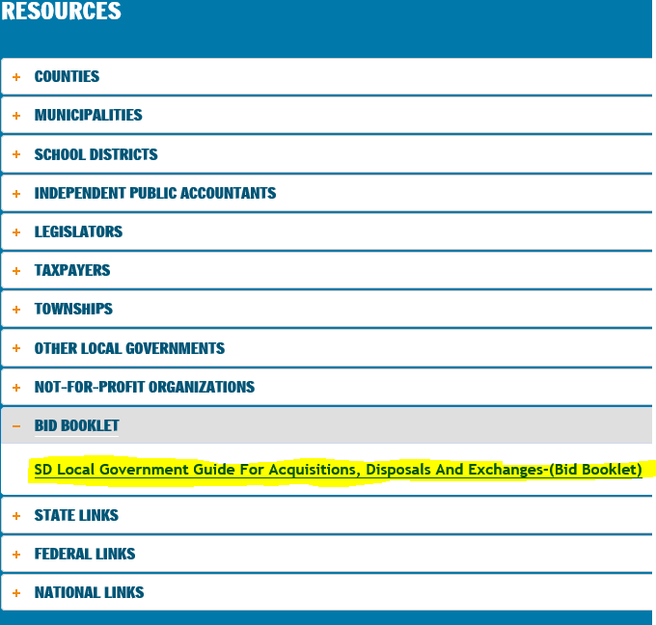
Updated Bid Booklet
SD Local Government Guide for Acquisition, Disposals and Exchanges (Bid Booklet)
Updated July 1, 2020
DLA Website
http://legislativeaudit.sd.gov/resources/resources.aspx

Slide 34
BID - LIMITS
$25,000 for supplies (except equipment) or services
Effective July 1, 2016, SB118 of 2016 Session increased the threshold for “equipment” to $50,000 for all public subdivisions. The threshold for supplies and services other than equipment remains at $25,000
Effective July 1, 2020, SB135 of 2020 Session increased the threshold for “public improvement” to $100,000.

Slide 35
BID - DEFINITIONS
Public Improvement – the process of building, altering, repairing, improving or demolishing any public infrastructure facility, including any structure, building, or other improvements of any kind to real property
Supplies – any property, including equipment, materials, and printing;

Slide 36
BID - APPLICATIONS
Multiple purchases – Aggregate for FY
Installment payments – focus on contract
Trade-in ---value of what you are acquiring
Piecemeal – breaking down a project

Slide 37
BID - EMERGENCY
When there is a threat to public health, welfare or safety or for other urgent or compelling reason
Bid notices are not required
Consider rentals
Declaration in minutes
Procurement must be made with such competition as practicable

Slide 38
PURCHASING COOPERATIVE
Any purchasing agency may enter into agreements with purchasing agents in this or any other state or the United States government under which any of the parties may agree to participate in, administer, sponsor, or conduct purchasing transactions under a joint agreement or contract for the purchase of supplies or contractual services. A purchasing agency may cooperate with purchasing agencies and other interested parties in any other state or the United States government to develop uniform purchasing specifications on a regional or national level to facilitate cooperative interstate purchasing transactions. (SDCL 5-18A-37)

Slide 39
BID EXEMPTIONS
ANY purchase of supplies or services, other than professional services, by purchasing agencies from ANY active contract that has been awarded by ANY government entity by competitive sealed bids or competitive sealed proposals or from ANY contract that was competitively solicited and awarded within the previous twelve months; 5-18A-22 (3)

Slide 40
BID EXEMPTIONS
A purchase utilizing another entity’s bid has to mirror a purchase from a contract that was “awarded” by the original bidding entity. It is not enough that such contract was “bid” by the original entity, it must have been “awarded”.

Slide 41
BID EXEMPTIONS
Contracts may be utilized from any government entity, including those that are out-of-state, however, care must be taken to ensure that payment is made to the original vendor and that the contract was awarded by competitive sealed bids or competitive sealed proposals as defined in SDCL 5-18A-1 (27), 5-18A-5 and 5-18A-7.

Slide 42
BID EXEMPTIONS
When buying off of another entity’s bid, make sure it is not a trade-in bid, and you are encouraged to secure (from the original entity) the following items:
Minutes approving contract
Specs
Affidavit of publication
All the bid proposals submitted

Slide 43
BID - EXEMPTIONS
Federal surplus property
Purchases of surplus property from another SD Purchasing Agency.
From the state price list
Local vendor matching the state price list
Real estate and auction services
Legal, audit, architectural and engineering, insurance, real estate services and auction services.

Slide 44
BID - EXEMPTIONS
Transportation of students (5 yr. limit)
Computer software
Communication technologies, computers, peripheral equipment and related connectivity
Perishable or unprepared foodstuffs
Raw materials used in construction or manufacture of products for resale
May buy off of GSA contracts

Slide 45
BID - BONDING
Bid bond – 5% cashiers or certified check or 10% bid bond ---provided by each bidder
Performance bond – in the amount of the contract----provided by the winning bidder
Bonding is only “required” for construction contracts
SDCL 5-21-1.3 does allow a public corporation to waive the requirement for a performance security bond for emergency procurements authorized by 5-18A-9

Slide 46
BID - OPENING
Two notices – first notice at least 10 days prior to the opening
Bids may not be faxed – must be sealed
Bids received “late” should not be considered

Slide 47
BID - OPENING
HB1102 of the 2016 Session--
Amends 5-18A-5 to allow up to 45 days between the bid opening and the award of the contract for supplies bids and the invitation to bidders for supplies must include the number of days the government will use. For services and public improvement bids, the requirement remains unchanged and the contract must be awarded within 30 days of the bid opening.

Slide 48
BIDS – FUEL (SDCL 5-18C-6)
Not required to publish two notices
Shall contact and attempt to obtain 3 quotes
Record of the names of suppliers, quotes received, and the procurement procedures used in purchasing shall be documented, noted in the minutes, and retained on file by the governing body.
May include a procedure for adjusting prices to meet changing market conditions not within the control of the vendor

Slide 49
Federal Grant Expenditures
Uniform Rules-Federal Awards
Procurement standards under the Uniform Administrative Requirements, Cost Principles, and Audit Requirements for Federal Awards (“Uniform Rules”)
Codified at 2 C.F.R. §200.317 through 200.326, which supersedes the procurement regulations formerly found at 44 C.F.R. pt. 13 (State, Local, and Tribal Governments), and 2 C.F.R. pt. 215 (Private Nonprofit Organizations)

Slide 50
Surplus Property
Auction –
Declare surplus
Two notices, first notice 10 days prior auction
An appraisal is not required
Hold the auction
Governing board members may buy at an auction

Slide 51
Surplus Property
Sealed bid process –
Declare surplus
Appraisal by three property tax payers
$500 or less -
Public or private sale without notice
Over $500
Two notices
May award to highest bidder
No bids--may reappraise or with 12 mos. sell at sale private sale not < 90% appraised value.

Slide 52
Surplus Property
Scrap and recyclable materials (scrap metal, used bridge plank, used culverts)
SDCL 34A-6-63.1
Establish policies for sale/disposal
Exempt from normal surplus property laws

Slide 53
Surplus Property
Real estate may also be sold through a realtor
Governing board has the right to accept or reject any sale

Slide 54
Surplus Property
SDCL 6-13-7. Persons prohibited from purchasing surplus property--Exception
No governing board member, any officer of a county, municipality, township, or school district, who has been elected or appointed, or real property owner acting as an appraiser may purchase the surplus property except at public auction.

