Slide 1
SD Towns and Townships
Overview of:
* Revenue Sources
* Special Assessments
* Road Districts
Ben Kyte
Minnehaha County Auditor

Slide 2
Towns and Townships
Primary Revenue Sources
Property Taxes
  Amount determined by prior year budget and requested budget submitted by November 1st.
  Can be increased annually by CPI (up to 3.0%) + growth in property valuations
County license fund collections
  SDCL 32-11-4.1 – Distribution of county license fund collections
  All funds collected for motor vehicle licenses in each county shall be distributed in the following manner:
    Fifty-four percent of all funds collected shall be transmitted to the secretary of revenue and credited to the local government highway and bridge fund;
      State determines allocation of funds back to counties and townships
    1A) Twenty-two and one-half percent shall be credited to the county road and bridge fund of the county in which they were collected;
    2) Fourteen percent shall be retained by the county and placed in a fund to be known as the special highway fund, which shall be used for the construction, reconstruction, and maintenance of roads and bridges in the county as provided by this section and §§ 32-11-5 to 32-11-9, inclusive. If the county in which funds are collected for motor vehicle licenses has completed the construction of the county highway system, the entire amount in the special highway fund shall be used for township roads, and the board of county commissioners may direct the county auditor to pay the collected amount directly to the townships pursuant to §§ 32-11-6 and 32-11-7;
    3) Five percent shall be forwarded to the municipalities within the counties in the following proportions: each municipality within each county shall receive funds in the proportion which the total street mileage of each municipality bears to the total street mileage of all the municipalities within the county. The apportionment shall be made quarterly by the county commissioners at the first meeting in January, April, July, and October. In any county having no municipalities, the five percent collection shall be placed in the county road and bridge fund of the county;

Slide 3
Towns and Townships
Primary Revenue Sources
County license fund collections (Continued)
  4) One and three-fourths percent shall be credited to the state motor vehicle fund; and
  5) One-fourth of one percent shall be credited to the county treasurer fund in the county in which the fees were collected to cover expenses for supplies such as toner, paper, etc.;
  6) Two and one-half percent shall be credited to the state license plate special revenue fund.
Revenue associated with
    Cars, Trucks, Trailers and Mobile Homes
Revenue determined by the number of road or street miles maintained by the entity
Wheel Tax
  32-5A-1. Wheel tax rate--Maximum vehicle tax.
  Each county may, by ordinance, impose a wheel tax on all motor vehicles, as defined in § 32-3-1, registered in the county at a rate not to exceed five dollars per vehicle wheel. The tax shall be administered and collected by the county. The total vehicle tax may not exceed sixty dollars per vehicle
  32-5A-2. Deposit, use, and distribution of proceeds.
  The proceeds from the tax created by this chapter shall be retained by the county and deposited in the county road and bridge fund, and the revenue may be used only for highway and bridge maintenance and construction. The board of county commissioners shall, by resolution, establish a means of distributing the revenue generated by this chapter among the county and the municipalities and townships located within the county.
  Proration in Minnehaha County
    90% to the County
    5% to Municipalities
    5% to Townships

Slide 4
Towns and Townships
Primary Revenue Sources
Other Revenues Sources
Motor Fuel Tax
    Allocation determined by the state
Special Revenue Fund
    Levy for road maintenance up to $0.50/$1,000
Other – prorated portion of Port of Entry fee
Bank Franchise Tax
Special Assessments

Slide 5
Towns and Townships
Special Assessments
Special Assessments
Ad Valorem vs Special Assessment
Ad Valorem is according to value
  For every $1000, a person must pay $1.00 in taxes
Special Assessment is per unit
  For every front foot on a lot, the taxpayer must pay $50 in special assessment
  For every homestead, the property sees a special assessment of $250
  It is the governing board’s responsibility to determine if they have legal authority to pursue a Special Assessment – not the County Auditor!
Payment – Municipalities
9-43-102 Resolution to specify payment under Plan One or Plan Two. All special assessments are payable under Plan One or Plan Two.
Plan One--Collection by county treasurer.
Plan Two--Collection by municipal finance officer.
Before any contract is let or before bonds are issued for any local improvement for which special assessments are to be levied, the governing body shall provide by resolution or ordinance whether the assessments and installments are payable under Plan One or under Plan Two. The resolution or ordinance may provide for the assessment to be divided into any number of annual installments not exceeding forty.
Assessment roll shall be delivered to the County Auditor not later than November 1. (SDCL 9-43-105 & 106)

Slide 6
Towns and Townships
Special Assessments
Nuisances – Municipalities, County, or Township
21-10-6 Abatement of nuisance--Notice required--Taxing cost of abatement--Civil action.
A public nuisance may be abated without civil action by any public body or officer as authorized by law. Any municipality, county, or township may defray the cost of abating a public nuisance by taxing the cost thereof by special assessment against the real property on which the nuisance occurred. If the nuisance abated is an unsafe or dilapidated building, junk, trash, debris, or similar nuisance arising from the condition of the property, the municipality, county, or township may commence a civil action against the owner of the real property for its costs of abatement in lieu of taxing the cost by special assessment. […]
Weeds – Municipalities
9-38-29 Destruction of weeds by park board--Special assessment against property to cover cost.
Should the owner of any lot fail to cause such weeds to be destroyed within two days after the last publication, the board may cause the same to be done. The expense thereof shall be paid out of the fund appropriated for the board and shall be certified to the auditor, and the same shall be levied as a special assessment against the property upon which such weeds were destroyed and when collected shall be covered into the park fund and be subject to the order of the park board.

Slide 7
Towns and Townships
Special Assessments
Weeds, Trees, Mowing – Townships
31-31-5 Failure of abutting landowner to remove weeds--Removal by board of supervisors--Compensation for removal.
If the owner or occupant of land abutting upon or adjoining township roads does not cut, remove, or destroy, or cause to be cut, removed, or destroyed, the grass, weeds, trees, crops, or brush in the right-of-way of such roads between the first day of September and the first day of October, or between the dates annually fixed by the board, the board of supervisors of the township in which the land is located may employ a person or persons to immediately cut and remove the grass, weeds, trees, crops, and brush on or in the right-of-way of such township roads with compensation at a rate to be fixed and paid by the board.
31-31-6 Payment for cleanup by landowner or township--Election to determine.
The voters at each annual township election shall by majority vote determine whether the amount paid for the cleanup of township roads pursuant to 31-31-5 must be paid for by the landowner or the township. If the vote is to have the landowner pay, the amount must be certified by the township clerk to the county auditor not later than November first of the same year. The amount must be extended on the tax list in a separate column headed "Removal or destruction of grass, weeds, crops, and brush on highways" and must become a tax on the land adjoining the highway where the grass, weeds, crops, and brush were cut or removed and must be collected as other taxes. If the vote is to have the township pay, the cost of cutting and removal of grass, weeds, crops, and brush must be paid out of township funds without extending such cutting and removal costs on the tax lists as tax on the land of the adjoining township landowner.

Slide 8
Towns and Townships - Special Assessments
MUNICIPALITIES | TOWNSHIPS
Nuisances – SDCL 21-10-6 | Drainage – SDCL 46A-11-4, 46A-11-5
Weeds – SDCL 9-38-29 | Irrigation Districts – Chapter 46A-4
Sewer Systems – SDCL 9-48-15 | Mowing – SDCL 31-31-5, 31-31-6
Sidewalks – SDCL 9-46-5 | Nuisances – SDCL 21-10-6
Solid Waste Management – SDCL 34A-6-29 | Sanitary Districts – Chapter 34A-5
Street and Alley – Chapter 9-45 | Tree Removal – SDCL 31-31-5, 31-31-6
Water Supply System – Chapter 9-47 | Water User District – Chapter 46A-9
 | Watershed – Chapter 46A-14
*These statutes represent only a selected few that pertain to special assessments. Always discuss your situation with your attorney, as they will be defending your actions in a court of law.

Slide 9
Towns and Townships
Road Districts / Special Assessments
Codified Law that governs County Road Districts is Chapter 31-12A
Codified Law that governs Township Road Districts is Chapter 31-13-15, 31-13-16 and 31-13-17
County Road District
31-12A-1. Incorporation of road district.
Any area outside the boundary of a municipality, which is situated so that the construction or maintenance of roads becomes desirable, may be incorporated as a road district pursuant to this chapter.
Township Road District
31-13-15. Road districts.
Each organized township may divide the roads or streets in the township into road districts which shall include not more than:
(1) One-half mile of township road which provides access to a rural subdivision or unincorporated town;
(2) Three miles of streets in an unincorporated town; or
(3) Five miles of streets in a rural subdivision as defined in § 31-13-32.
31-13-16. Petition for improvement of road district--Notice to property owners.
Whenever the owners of eighty percent of the property fronting upon any road in a road district established pursuant to § 31-13-15 shall by petition in writing filed with the township clerk request that the property in the road district be assessed for road improvement, the supervisors shall set a time for hearing the petition and notice shall be given to the abutting property owners whose property it is proposed to assess who shall not have joined in the petition, by either delivery to the property owners of a copy of the notice of hearing or by mailing a copy of notice of hearing to such abutting property owner at his last known post office address, or if such address cannot be determined, then by publishing such notice in a legal newspaper designated by the supervisors as most likely to give notice, which notice shall be given at least ten days prior to the hearing.

Slide 10
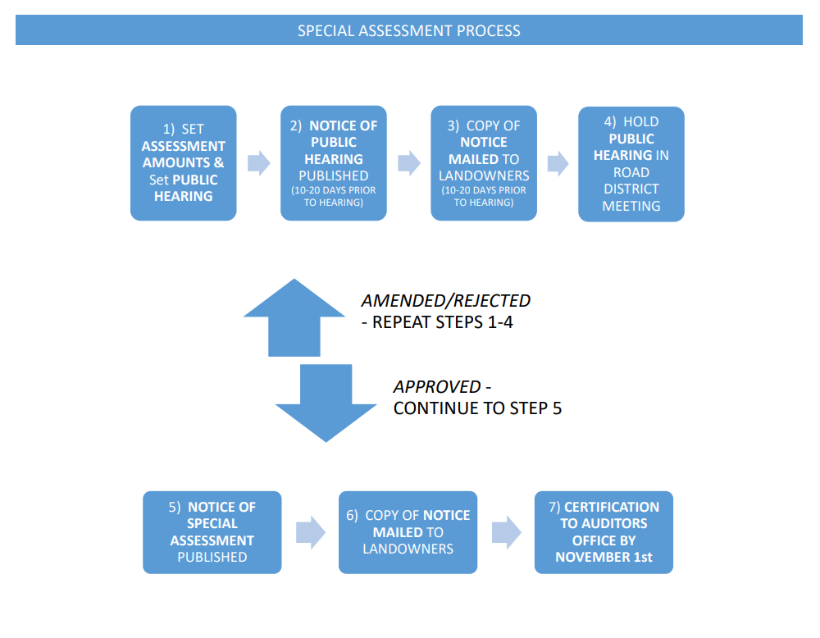
Towns and Townships
Road Districts / Special Assessments

Slide 11
Towns and Townships
Road Districts / Special Assessments
Codified Law that governs County Road Districts is Chapter 31-12A
SPECIAL ASSESSMENTS (SA)
Authority is given to Road Districts to levy and making SA under SDCL 31-12A-25 . This statute states that making of SA shall be governed by the rules of Chapter 9-43 , which are the laws that cities use.
The South Dakota Municipal League Guide to Special Assessments has an substantial explanation of each step of the process of how a SA should be passed. The Flowchart is a pared down, more easily digestible version of the process. The important thing is that there are multiple steps that should be followed and if these steps are not met, then the SA may not be valid. Any time a tax process is questioned, the County Auditor should discuss with there States Attorney on whether or not they should accept the request. I would highly recommend the County Auditor ask for all documentation if there is ever any doubt whether something was implemented correctly. The onus is on the taxing district to prove that they have the authority to do a SA, as well that they followed all necessary steps.
REFERENDUM of SA
If a taxing district passes a SA after the public hearing, and the taxpayers of the district are against their decision, the taxpayers have a right to refer that decision to a vote. This can be found in SDCL 31-12A-23 , which states that a petition of 5% of the eligible voters of the district can refer any SA to a vote of the people. (I have attached a general example of a petition from Administrative Rule.) The petition must be filed with the clerk of the district within 20 days of the notice given to the landowners.
The requirements of an election from a referendum can be found under SDCL 9-20-11 . Within 10 days of receiving the petition, the board can call a special election. They must wait at least 30 days before having the actual election.
ELIGIBLE VOTERS
Eligible voter and landowner for a road district is defined under SDCL 31-12A-1.2.
Additional guidance regarding who can vote in a Road District election:
What if a person owns more than one lot, parcel or tract? That person is only allowed one vote even if he/she owns more than one lot, parcel or tract. Is the vote limited to one per person or one per person per lot? The vote is limited to one vote for one person who owns a lot(s), parcel(s) or tract(s). A voter can only vote once no matter if he/she owns multiple lots, parcels or tracts.

Slide 12
Towns and Townships
Special Assessments
Of course if it is only one vote per person, if a couple owns more than one lot, can they each vote once? No, the couple will have to determine who will cast the one vote between them, even if they own multiple lots, parcels or tracts.
If a voter is selected to vote for a corporation or a minor, and if they own land in the area do they get to vote more than once? Yes. That person can vote the proxy vote for a minor or the corporation and still cast a vote for himself/herself on the lot(s), parcel(s) or tract(s) he/she owns. As long as those lot(s), parcel(s) or tract(s) are not the same for the person as they are for the corporation or minor.
Additional points:
Only landowners in that district can vote in the formation election or any subsequent election of a road district. If a person rents property in the proposed or formed district, they cannot vote unless they are a landowner of land within that road district.
If the same corporation owns multiple lots, parcels or tracts - that corporation only gets one vote even though the corporation owns multiple lots.
If a person is a stockholder of a corporation who owns lot A, and in a partnership with a corporation that owns lot B, and a stock holder in a corporation that owns lot C – there would be 3 votes available and one person can be designated to vote all three of those votes.
SDCL 12-26-8 does not apply to a person who votes a proxy for a minor or a corporation and also votes his vote as a landowner: 12-26-8. Voting more than once at any election as felony. A person who votes more than once at any election or who offers to vote after having once voted, either in the same or in another election precinct in South Dakota or elsewhere, is guilty of a Class 6 felony.

Slide 13
Towns and Townships
Special Assessments
MEETING MINUTES
SDCL 31-12A-20 requires the board keep full records of all proceedings of the board. They are open to inspection under the public records rules of Chapter 1-27. I do not see that there is any further requirements for publication or reporting of the minutes specific to a road district.
BYLAWS
The bylaws is a single document that outlines and encompasses all of the general governing rules of the group at the time the district is formed.
I am unable to find any state level oversight. Since bylaws are the rules put in place by a group to regulate its members and maintain civility, it appears that they are only overseen by the membership of the district. I did find that if an organization has a nonprofit status with the federal government, then they must report all changes of bylaws to the IRS.
Sometimes there are requirements or processes outlined in the original bylaws stating how future changes can be made (example, it may state that they can only be done at an annual meeting.) Typically, to change bylaws, a resolution must be created and approved it must be voted on the members of the district at an open meeting. A majority of the board is needed to adopt or change any such rules and regulations (see SDCL 31-12A-19).

