Slide 1
SOUTH DAKOTA ASSOCIATION OF TOWNS AND TOWNSHIPS
HOT TOPICS, UPDATES, REMINDERS

Slide 2
New Membership Items
Notes:
Until this process gets set up please be in contact with your County regarding any bridges that need rehabilitated or replaced as the Bridge Improvement Grant applications are due January 2, 2017.

Slide 3
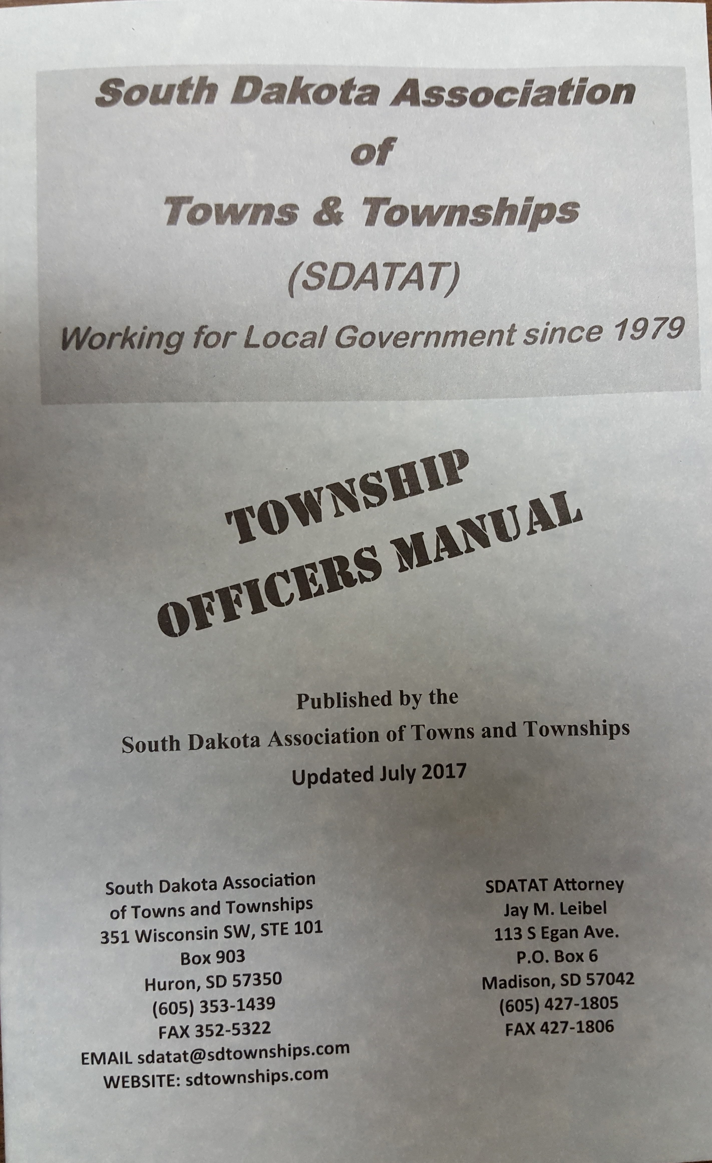
A New Township Officers Manual for 2023 Calendar
Direct contact through SDATAT for Legal Interpretation
Reduced fee for Attorney council for your township

Slide 4
MEMBERSHIP REMINDERS & EXPLANATIONS:

Slide 5
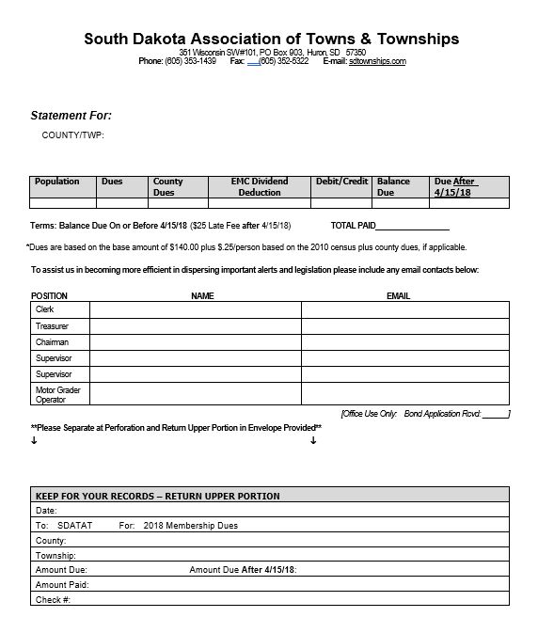
Understanding Your Membership Statement
Based on 2020 Census-Total Population
Dues = $140 + $.25/person
Collected for Your County Twp Assoc.
Deducted for EMC Members less than dues
Misc Deductions/Additions Overpayment, etc
Amount Due before April 15th
After April 15th with Late Fee
Email address will be sued to send direct information from SDATAT
Keep For Your Records

Slide 6
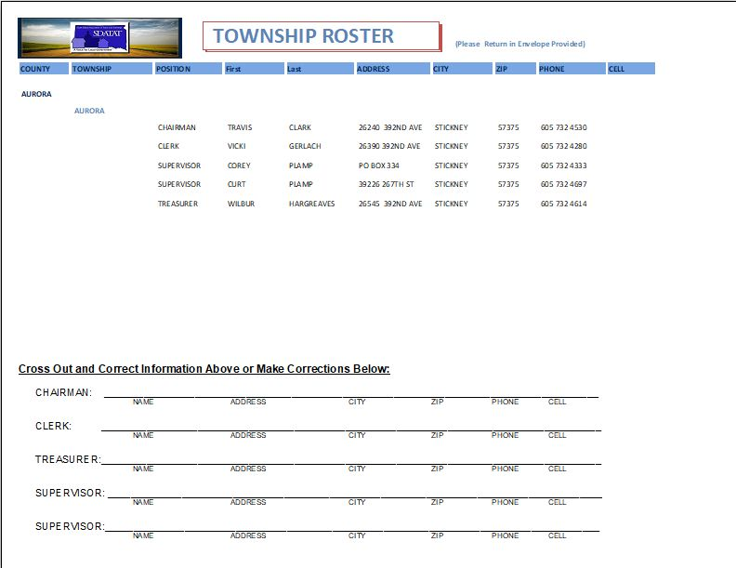
Your Township Roster
Two Ways To Make Corrections
Please Fill Out Even if You Are NOT a Member

Slide 7
Are You Bonded With SDATAT?
PLEASE!!
The clerk and treasurer are required to completely fill out the Application Each Year.
Notes:
Because if you don’t……

Slide 8
Bond Application must be fully completed each year:

Slide 9
Township Legislation Passing this Year:
HB 1147 Clarification in process for townships to merge, organize, reorganize
HB 1148 Clarify registration and residence requirements for voting in township meetings.
SB 73 Includes township owned self propelled equipment eligible to use dyed fuel
SB 145 Expands eligibility to apply for RAIF funds

Slide 10
Snow Removal
Full Maintenance Roads Need to be kept “Passable”
Winter Maintenance Should be Adopted at Your Annual Meeting
View Map to Review Resident Access
Resolution Passed By The Board the Last Tuesday of February
Bus routes “may” be provided snow removal at supervisor discretion
Snow removal routes should be shared with the emergency services and post office, as they prepare their delivery routes in the summer.
Townships May Establish a Snow Removal Fund $.60/ thousand
Bus routes declared minimum maintenance must be published

Slide 11
Trees, weeds, crops in the ROW
31-31-2 Owner or occupant of any land adjoining/abutting township roads are required to remove/destroy grass, weeds, trees, crops, brush so as to be cut with a mower.
31-31-3 Time for removal is between September 1st and October 1st, or the time annually fixed by board of supervisors.
31-31-5 If failure to mow or cut growth within the allotted time, the board of supervisors may employ persons to complete the work at a rate fixed by the board
31-31-6 Payment for clean up-. The voters at the annual meeting shall by majority vote determine whether the amount paid for cleanup will be paid for by the landowner or the township. If the landowers will be responsible for the cost, it must be presented to the county auditor before November 1st.
The township may include in the cost of removal, an administrative fee.
If the supervisors set an alternate date and set an administrative fee above the cost of removal, this must be published or sent in a letter to each township resident.

Slide 12
Questions About the Annual Meeting
Reminder: clerk and treasurer become regular voters at the annual meeting
What do township registered voters vote upon?
Any increase in taxes assessed against the township
Secondary Road Capital Improvement Fund (up to 50 cents/thousand)
Establish levy for fire protection or for snow removal
Set salary for Township Board
Rate of annual and daily compensation for meetings, inspections
Hourly rate for emergency or disasters above usual duties
Ratify and approve all board actions for end of current fiscal year.
Weed and tree removal control- who pays.
Purchase of equipment in excess of $15,000

Slide 13
Specific Procedures for Mitigating right of way issues…
Tree Removal
Mowing weeds/grass/crops
Damage to ROW (ditches, trenches, drainage)
Damage to road (cutting thru road, pivot overspray)
Farming the right of way (intentional damage to ditch)
Obstructions (fences, rocks) to be removed
Vacating section lines
Handouts are available on our web at www.sdtownships.com under the “Membership Only”
Password protected.
If you are a member, you can call the office at 605 353-1439 and request the password.
Notes:
Limited number of handouts are available.
Can also access all handouts on our web at www.sdtownships.com under the “Membership Only”
Password protected. If you are a member, you can call the office at 605 353-1439 and request the password.

Slide 14
Notes
**It is the AG’s opinion 76-1 that townships are responsible for noxious weeds within the right of way. Below is the link e
Here is an excerpt from Attorney William Janklow opinion in 1976:
It is my opinion that 31-31-2 does not authorize a township to require a landowner to control noxious weeds in township road ditches adjacent to his property.
SDCL 31-31-2 cited above refers to "grass, weeds and brush." SDCL 38-22-22 and 24 cited above specifically refer to "noxious weeds" and it is the responsibility of the township in this instance to control such noxious weeds. SDCL 38-12-2 and 3 contain statutory definitions of what constitutes "noxious weeds." It appears to me that the above cited statutes must be construed together yet giving effect so far as possible to the provisions of each section. It may be somewhat difficult to administer, but it appears that control of noxious weeds is a matter for the township, whereas control and removal of grass, non-noxious weeds, brush, trees and crops* growing within the right-of-way of township roads is a responsibility of the adjoining landowner. Respectfully submitted, WILLIAM J. JANKLOW *law updated in 2022 ATTORNEY GENERAL

Slide 15
Tax Levy for Secondary Road Capital Improvement Fund
DOES NOT Need to be the Full $.50/$1,000…May Have any Portion “Up To” $.50
DOES Need to be Approved Each Year
May ONLY be Approved at Your Annual Meeting
Any RESIDENT, REGISTERED VOTER May Vote
It IS NOT REFERRABLE. Voters Must Attend the Meeting.
Clerk MUST Inform the County Auditor if Levy is Passed AND Provide Meeting Minutes Showing Voting Outcome

Slide 16
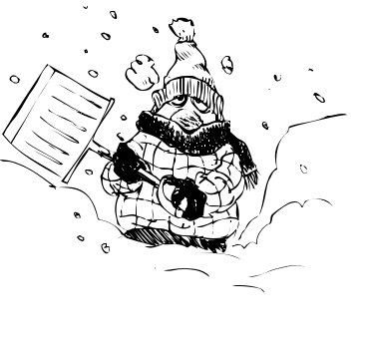
Reschedule Date For Meetings
The reschedule date is for annual, regular and required Township meetings that are postponed due to inclement weather.
The reschedule date will be held one week later . No need to re-publicize or re-print the agenda. The original agenda must specify the reschedule date.

Slide 17
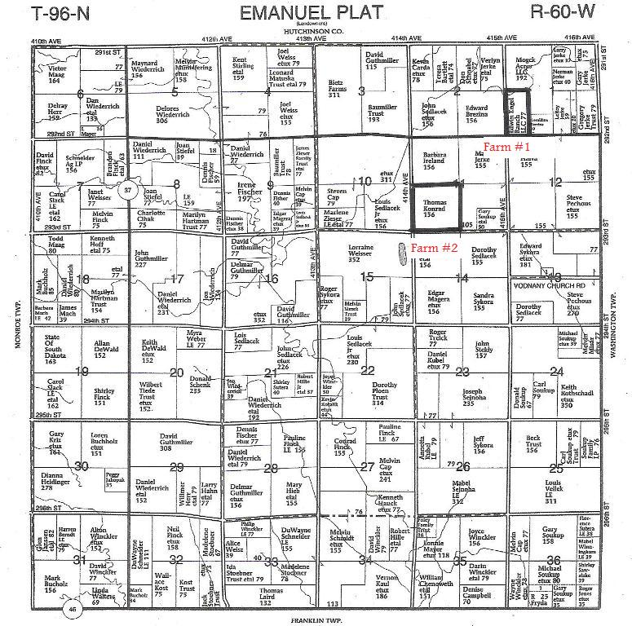
Don’t Forget to Turn In Your Plat Maps to the County After Your Annual Meeting
Notes:
Designate Maintenance Level of Township Roads- The supervisors set the level of maintenance for roads (full, minimum or no maintenance) and must be adopted in annual meeting. Use the plat books and have designations recorded in the minutes. Townships shall file with the County Auditor a map of the township designating which roads are full maintenance, minimum maintenance and now no maintenance. By indicating to the county auditor the total miles maintained, the apportionment of license plates is then calculated and distributed accordingly. SDCL 31-13-1.1 through 1.6

Slide 18
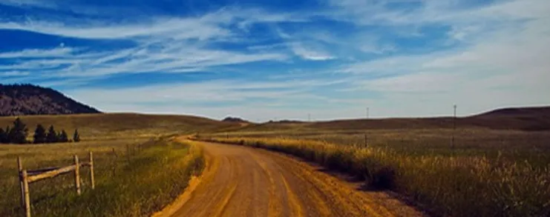
SDATAT WEBSITE
www.sdtownships.com
Welcome to South Dakota Association of Towns and Townships
"A Voice for Local Government"
The Mission of the SDATAT is to serve, preserve,
and represent small towns and townships.
Notes:
Contact Us
Members can put in items for sale or items wanted for free
Current News, Calendar of Events, Links to helpful sites
Legislative Newsletters, Quarterly Newsletters, Information on our Bonding Program, Update your roster
Many Resources in our “Members Only” section: sample agendas, sample letters, a searchable township officers manual, bid books, brochures, power points, and much more.

Slide 19
SDLTAP – Great resource for Townships
The South Dakota Local Transportation Assistance Program (SDLTAP)
SDLTAP translates the latest highway and bridge technology into understandable terms for local government entities throughout the state. In linking transportation technology and local government, SDLTAP keeps local government officials informed about new publications, techniques, and training opportunities that may benefit their communities.”
“SDLTAP also offers training workshops on topics, such as, asphalt maintenance, asphalt paving, culvert installation, defensive driving, geotextiles, personnel management, risk management, safety awareness, surveying, winter maintenance, work-zone traffic control, and gravel roads.” Contact us at:
Andrew Peterson, Field Service Manager - andrew.peterson@sdstate.edu
Cell: 605-661-7882 Office: 605-688-4138

Slide 20
Recorded Video Training, Webinars & Conferences (Examples)
Basic Sign Installation and Maintenance
Gravel Roads Maintenance
Impacts of Agricultural Equipment on Highways
Maintenance Decision Support Systems and Weather Forecasting for Beginners
Rural Road Safety through Maintenance Operations Training
Snowplow Operator Training
http://tln.learnflex.net

Slide 21
REMINDER
MARK YOUR CALENDARS FOR THE 2023 SDATAT ANNUAL CONVENTION!
Thursday & Friday, Dec. 7-8,
Chamberlain, Cedar Shore Resort
Notes:
Friday – SDLTAP Road Show, Preparing for Disaster, Active Shooter Training, Evening Meal w/ Entertainment
Saturday – Keynote Speaker, Atty Gen. Marty Jackley, Legal Insights, Workshops, Awards, Annual Mtg, Door Prizes

Slide 22
THE END

