Slide 1
What's My Job??
A Job Description for Township Officials in South Dakota

Slide 2
Interesting Township Facts
Township Gov’t began in North America in 1636.
Township government is the longest, continually functioning unit of government- (possible exception is Native American Nations)
Training Ground for Higher Office
Notes:
38 of 56 signers of the Declaration of Independence personally experienced the benefits of township government.
South Dakota authorized in 1873
Minnehaha was first county to organize townships in 1879 when we were known as the Dakota Territory
South Dakota became state on Nov. 2, 1889
Maximum amount (3 mills) that township can levy remains the same as it was back in 1872

Slide 3
Facts Continued..
South Dakota
Most townships elect 3 supervisors, a clerk, and a treasurer
The Original Dakota Territory
Annually chose:
3 supervisors, a clerk, a treasurer
an assessor
an overseer of the poor
and an overseer of highways for each road district.
Notes:
While Dakota Territory- they also had 2 justices of the peace and 2 constables- however those positions were elected once every 2 years

Slide 4
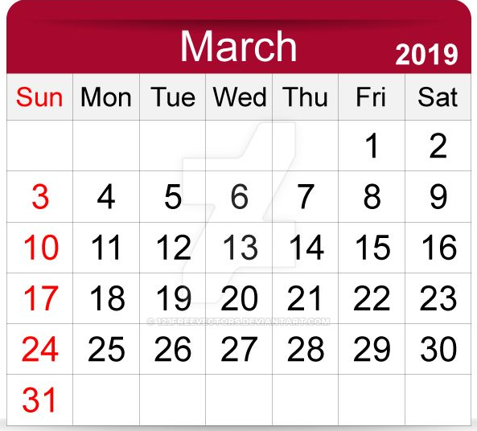
Meetings:
Three Regular Required Meetings:
The last Tuesday of February
The last Tuesday in March
The last Tuesday of October
Annual Meeting and Election
The first Tuesday of March
Equalization Meeting
SDCL 10-11-13
A quorum of the board meet the 3rd Monday of March and may adjourn from day to day over 5 consecutive days to complete the equalization
This Photo by Unknown Author is licensed under CC BY-SA
Notes:
Dates of regular, required meetings can only be changed if 2 supervisors submit a statement signed by them not less than 12 days before the required meeting date and then notice is publicized as required in 8-3-1.
Annual meeting date is codified in law and may not be changed. It can only be postponed due to inclement weather, to the following Tuesday. This should be noted in the advertising of the first date. It will not need to be re-advertised.

Slide 5
Meetings Continued..
Regular and Required Twp meetings:
Post the proposed agenda & notice of Meeting – Principal Office – 24 hours prior.
All township meetings and records are open to the public.
Few exceptions. A period for public comment must also be given.
Annual Meeting/Special Meetings:
Advertise as Required: 8-3-1 Published 2 consecutive weeks in weekly newspaper not less than 12 calendar days prior to meeting.
Notes:
Annual meeting or Special meetings: Require publication twice (2x) in a weekly legal newspaper not more than 12 days prior to meeting or
3 consecutive days in a daily newspaper. MUST be LEGAL newspaper. The Green Sheet or other ag publications are NOT legal newspapers. You can utilize them in addition to your legal newspaper but NOT as a substitution for them.
Special meetings or elections are meetings where the public must vote on an issue such as a special election or a public hearing is required. Those types of meetings MUST be publicized.
Regular township meetings doing township business only require:
Posting the agenda for your meeting at the principal office of the public body holding the meeting 24 hours prior to your meeting.
It is highly recommended that only what is on the agenda are the only things to be acted upon at the meeting. If other items come up, they should be for discussion only and action taken at a future board meeting.
All township meetings and records are open to the public- Except executive meetings and personnel records. Must be specific purpose of executive session such as personnel matter or pending litigation.

Slide 6
Meetings
All township officials must be resident registered voters of their township.
Only Chairman or Clerk may schedule additional township meetings if needed
Fellow township officials must be notified 3 days in advance of upcoming township meeting
The three supervisors are the only voting members of the township board, except at the Annual Meeting.
Only resident registered voters of the township can make motions and vote at their township annual meeting.
Guidelines
Notes:
You can be considered a resident if you live 30 consecutive days in your township. However you must be registered in that township.
(SDCL 8-5-2) At each regular meeting, the board of supervisors shall perform the duties required of it by law and transact any other business that may legally come before it. The board may adjourn from time to time. The township clerk or the chairman of the board of township supervisors may call special sessions if the interests of the township demand it upon giving three days’ notice of such session by mailing a copy of such notice to each of the supervisors at their several post office addresses or by giving notice to each supervisor by telephone.
(SDCL 8-5) outlines the general responsibilities of the Board of Supervisors.

Slide 7
Board of Supervisors
3 Supervisors
One supervisor is elected each year at the Annual Township Meeting for a 3-year term.
Senior member of the board of supervisors is the chairman for the coming year
(definition of senior)
Notes:
Township meeting held the first Tuesday in March.

Slide 8
Meeting/Vacancy/Compensation
The Board of Supervisors, by resolution, sets the place for the annual meeting held the first Tuesday in March each year.
A board vacancy may be filled by supervisor appointment until the next annual meeting or call a special election of the township members for election.
There is no set fee for compensation to Board Members, determined by vote at the annual meeting.
An hourly compensation should be set for over and above the usual duties of officers.
Notes:
Compensation is to be set at the Township Annual Meeting by the voters of the township.

Slide 9
Responsibilities of Board of Supervisors…
Has authority to disburse funds for best interest of the township.
Perform the duties of a board of equalization of township assessments
Hear appeals from aggrieved citizens

Slide 10
More Township Supervisor Responsibilities…
Roads, rights of way and fire protection.
The road section of codified law is found in (SDCL 31).
Much of that chapter is found in the Township Officers Manual.
Notes:
All township officials should be informed of laws governing townships, most laws are found in the manual published by SDATAT.
Use agenda found in the back of the manual for the township annual meeting held the first Tuesday in March each year.

Slide 11
More responsibilities of the Board of Supervisors:
Auditing of Accounts:
The Board of Supervisors shall audit all accounts payable and receivable by the township.
WHAT DOES THIS MEAN?
Notes:
The Board of Supervisors shall, at its regular meeting on the last Tuesday of February in each year, examine and audit the accounts of the treasurer; and it shall audit the accounts of all other officers who are authorized by law to receive or disburse any money of the township by virtue of their offices (SDCL 8-10-28).
if for any cause there are not three supervisors present, the chairman, or in his absence either of the supervisors, may notify the clerk of the township, who together with the supervisors present, shall make a board of three; and the board so constituted shall have authority to act as such board (SDCL 8-10-15).
, and at such other times as it deems necessary and expedient, for the purpose of auditing and settling all charges against the township; and it shall state on each account the amount allowed by it; but no allowances shall be made for any account which doesn’t specifically state each item of the same and the nature thereof (SDCL 8-10-17).
SDCL 8-10-16: Supervisors shall also audit and settle all charges against the township on last Tuesday of Oct.

Slide 12
The Board of Supervisors shall, at its regular meeting on the last Tuesday of February in each year, examine and audit the accounts of the treasurer; and it shall audit the accounts of all other officers who are authorized by law to receive or disburse any money of the township by virtue of their offices (SDCL 8-10-28).
if for any cause there are not three supervisors present, the chairman, or in his absence either of the supervisors, may notify the clerk of the township, who together with the supervisors present, shall make a board of three; and the board so constituted shall have authority to act as such board (SDCL 8-10-15).
, and at such other times as it deems necessary and expedient, for the purpose of auditing and settling all charges against the township; and it shall state on each account the amount allowed by it; but no allowances shall be made for any account which doesn’t specifically state each item of the same and the nature thereof (SDCL 8-10-17).
SDCL 8-10-16: Supervisors shall also audit and settle all charges against the township on last Tuesday of Oct.

Slide 13
Board of Supervisors…
The Board of Supervisors is strongly encouraged to purchase Liability Insurance & Errors and Omissions Insurance.
All township decisions are to be made by the entire board of supervisors in an official board meeting and not by individual supervisors.
If there is a conflict of interest- supervisor should recuse themselves from voting.
Notes:
(SDCL 8-2-7) The board of supervisors may obtain and pay for public liability insurance. Although the law says may, the South Dakota Association of Towns and Townships strongly encourages every township to consider purchasing liability insurance and errors and omissions insurance to protect the township and the township board members.
SDCL 8-9-1. Contracts unlawful unless made at board meeting. All contracts made by any civil township officer or supervisor, in his capacity as such officer, except contracts made at a regular or special meeting of the civil township board, shall be deemed unlawful and not binding upon such civil township.

Slide 14
Contracts
Contracts must be made at a township regular/special meeting.
No single officer has the authority to enter into an agreement or contract on their own.
Township officers should not have an interest in any contracts of the township.
There are a few exceptions, but this issue can become one of great conflict within the township.
Notes:
These agreements and/or contracts are board decisions and must have a 2/3 majority of the supervisors for approval. Examples may include such agreements/contracts such as: fire contracts, boundary line road agreements, road repair agreements, etc.

Slide 15
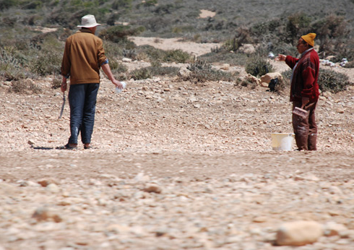
Illegal Meeting or not? It depends …
Situation: Two supervisors (quorum) meet on a township road, discuss township business & make decision.
Notes:
If the township supervisors met and made a board decision without posting notice of their meeting and time- this meeting would be deemed illegal and any decisions made, null and void because of the violation of the open meeting laws.
However, if the supervisors were simply on a fact-finding mission regarding public safety or carrying out their ministerial duties on previously adopted policy, and did NOT make any decision, it is not a violation of the open meeting laws. The point to remember is that the supervisors are NOT making any decisions. They are either just gathering information or they are meeting to carry out a specific function that is related to public safety. Examples include: putting in culvert or putting up sign that was already voted on earlier; doing culverts inspections; or simply checking the integrity of the roads.

Slide 16
Duties of the Township Clerk
Record minutes of EVERY meeting in which there is a quorum, in the book of townships records.
Enter every order or direction, rules, regulations or vote of such meetings.

Slide 17
More Clerk’s Duties
File and preserve all accounts audited by township board and enter a statement thereof in book of records.
Notice: The clerk is to
“file and preserve” –
the clerk is NOT
the treasurer
Notes:
A Records Retention and Destruction Schedule is available and would be adopted by the board of supervisors.

Slide 18
Records Destruction & Retention Schedule
Township clerk may destroy any record which the records destruction board, acting pursuant to (SDCL 1-27-19) declares to have no further administrative, legal, fiscal, research or historical value. (SDCL 8-6-3).
A destruction schedule published by the SD
Board of Administration may be adopted by the township board
A copy of this schedule is found at the website sdtownship.com

Slide 19
More Clerk Duties …
Publish notices / post agenda of all meetings.
File annual fiscal report of the township with the county auditor by the last day of March.
Call annual meeting to order.
Notes:
SDCL 8-6-7. Filing annual fiscal report. The township clerk shall file the annual fiscal report of the township with the county auditor pursuant to § 6-9-1 by June first of the year immediately following the close of the township's fiscal year
SDCL 6-9-1. Annual fiscal reports to county auditor by township, municipal and school district officers--Contents--Filing. The clerk of each township, third class municipality, or school district, and every municipal auditor shall report to the county auditor of each county in which the municipality or school district is situated, the total indebtedness and the purpose for which issued and the liabilities, assets, resources, and expenditures, and the total receipts and disbursements as of December thirty-first of the preceding year, or as of the closing date of the last fiscal year.
The reports shall be filed and kept by the county auditor of each county in a suitable record. However, the county auditor may destroy any record which the records destruction board, acting pursuant to § 1-27-19, declares to have no further administrative, legal, fiscal, research, or historical value.

Slide 20
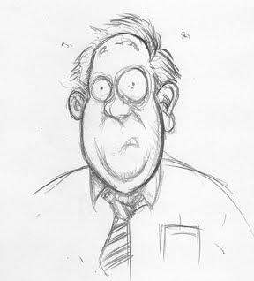
And Yet More Duties of the Clerk!
Administer the oath of office to each elected official.
Clerks are elected for a one year term at the township annual meeting
The clerk is a non-voting member of the township board.
Notes:
Oath of office must be administered to all officials prior to them performing their duties and oaths must be filed with county auditor 10 days after election.

Slide 21
Bonding
Purpose: to restore funds if misused or stolen by clerk or treasurer
The Clerk bond amount is set by the township supervisors
Bonding needs to be executed before entering the office
The bond is to be filed in the office of the County Auditor
Notes:
(SDCL 8-6-1) Any person elected or appointed to the office of township clerk shall, before the person enters office, and within the time prescribed by law for filing the oath of office, execute a bond, conditioned upon the faithful discharge of the duties of the office, paid for by the township, and with a surety company authorized to conduct business in this state or through a pool arrangement as provided in (SDCL 1-24-11 to 1-24-17) inclusive. The bond shall be for an amount set by and approved by the board of County Commissioners and filed in the County Auditor’s office.
The bond is set at an amount not more than $200,000.

Slide 22
Duties of the Treasurer:
Shall receive and take charge of all money belonging to township.
NOTICE: The treasurer shall receive and take charge of all money belonging to the township.
It is NOT the clerk’s responsibility to be in charge of the checking account.
Notes:
Treasurer’s responsibility to be in charge of the checking account is found in: (SDCL 8-7-2).

Slide 23
Treasurer - Bonding
Any person elected or appointed shall give to the county a bond, conditioned upon the faithful discharge of the duties of the office, paid for by the township, and with a surety company authorized to conduct business in this state or through a pool arrangement as provided in (SDCL 1-24-11) or (1-24-17) inclusive.
The bond shall be a set amount approved by township supervisors and filed in the office of the county auditor. Bond shall be set for an amount approximately equal to the sum of money that the treasurer is expected to receive in any one fiscal year (SDCL 8-7-1).
Notes:
Duties are found in (SDCL 8-7), first section talks about the bond.

Slide 24
Signatures
If only checks are used, the bills must be approved by 3 supervisors or 2 supervisors and the clerk before a check can be issued (see SDCL 8-10-16). The three persons should sign each bill.
Ideally, there should be three signatures on each check: Clerk, Treasurer, and supervisor Chairman
Three signatures are required if participating in the Township Bond Alliance administered by SDATAT

Slide 25
CONSTABLE
An unincorporated small town in South Dakota still has a law allowing a constable may be elected.
The term of constable is two years. (SDCL 8-3-13).
Notes:
There are only two short sections found in (SDCL 8-8) addressing the duties of a constable. Basically, they have the power to arrest and detain persons for disorderly conduct in township containing an unincorporated town.

Slide 26
Membership with SD Association of Towns & Townships
Renewal Forms
Mailed to township primary contact- typically the clerk
Mailed in February & due before April 15th
Must provide mailing address and phone for each township officer
Email addresses provided receive important updates
Bond Alliance
Created to reduce cost to bond clerk and treasurer
Strict oversight by supervisors is required
Single premium of $600 will provide $50,000 bond
Must return renewal on time (April 1st) or risk lapse of coverage

Slide 27
What is SDATAT?
Organized in 1979 & Incorporated in 1980
Governed board of directors
Employees include:
Executive Director
Part time Assistant
Lobbyist
Attorney on Retainer
Local & Legislative involvement
Up to 13 directors and includes a small town
Hold positions for up to 4-3 year terms
Each year in April a President, Vice President, Treasurer and Secretary are elected

Slide 28
SDATAT Annual Meeting
Always held the first part of December.
Educational support to township officers in their official roles and responsibilities
Provide up-dates on State issues.
Attendance: Township are authorized to pay for registration, mileage, per diem, and motel room for board members attending.
Your input and sharing ideas for speaker presentation topics is appreciated.

